Slide 1
Informatik E1 Abels

Slide 2
Wie sieht das Box Model in CSS aus?

Slide 3
<article> <div> <figure> <footer> <form> <h1>-<h6> <header> <li> <main> <nav> <ol> <p> <table> <ul> <video>
<a> <b> <br> <button> <code> <i> <img> <input> <label> <select> <span> <textarea>

Slide 4
padding: 30px;
padding: 10px 40px;
t + b + r + l
t + b
r + l
padding-top: 10px;
t
padding-left: 40px;
padding-right: 20px;
l
r
padding-bottom: 30px;
b
padding: 10px 20px 30px 40px;
padding: 10px 20px 40px;
t
r
b
l
t
r + l
b

Slide 5
border-style: dotted | dashed | solid | double | dotted dashed solid double | none;
border-width: 5px | 5px 10px 4px 35px;
border-color: red | red green blue yellow | #ff0000 | rgb(255, 0, 0) | hsl(0, 100%, 50%);
border: 5px solid red;
border-radius: 50%;
border-left: 6px dashed lime;
border-bottom-left-radius: 5px;

Slide 6
margin: 30px;
margin: 10px 40px;
margin-top: 10px;
t + b + r + l
t + b
r + l
t
margin-left: 40px;
margin-right: 20px;
l
r
margin-bottom: 30px;
margin: 10px 20px 30px 40px;
b
margin: 10px 20px 40px;
t
r
b
l
t
r + l
b

Slide 7
Box Model
Clears an area outside the border. The margin is transparent.
A border that goes around the padding and content
Clears an area around the content. The padding is transparent
The content of the box, where text and images appear

Slide 8
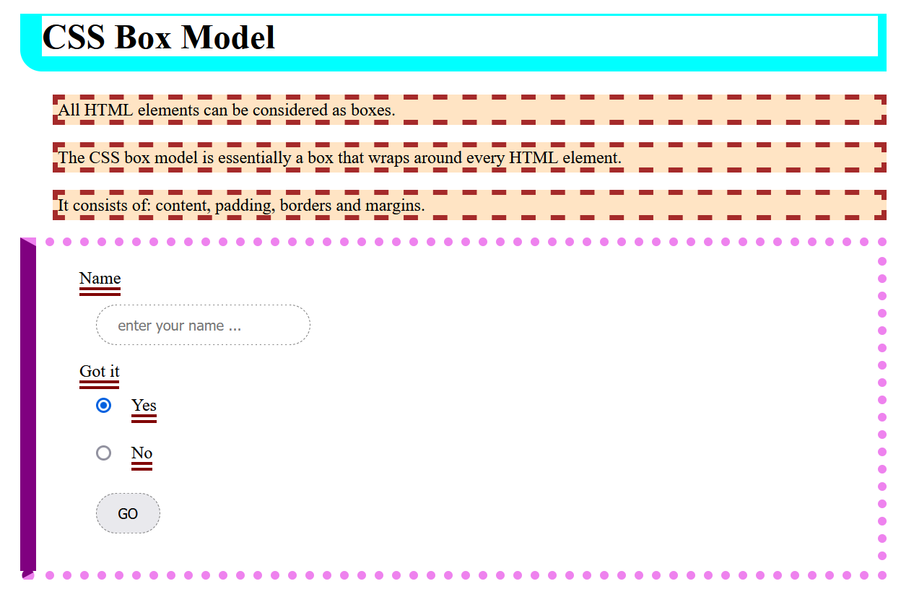
Übung 1
Erstelle eine Website Boxmodel.html nach folgender Vorlage.
aqua
brown
bisque
purple
violet
maroon

Slide 9
Boxmodel

Slide 10
Erweitere deine Website book.html um die neu erlernten Elemente und Properties.

