Slide 1
Mathematik 9 Abels

Slide 2

$\sqrt{48}=$
$\sqrt{\frac{100}{288}}=$
$\sqrt{32}−\sqrt{8}=$

Slide 3
Was ist eine Intervallschachtelung ?

Slide 4





Slide 5

Intervallschachtelung
$$\sqrt{2}≈…$$
$1^{2}=1<\sqrt{2}<2^{2}=4$ $⇒$ $1<\sqrt{2}<2$
${1,4}^{2}=1,96<\sqrt{2}<{1,5}^{2}=2,25$ $⇒$ $1,4<\sqrt{2}<1,5$
${1,41}^{2}=1,9881<\sqrt{2}<{1,42}^{2}=2,0164$ $⇒$ $1,41<\sqrt{2}<1,42$
${1,414}^{2}=1,999396<\sqrt{2}<{1,415}^{2}=2,002225$ $⇒$ $1,414<\sqrt{2}<1,415$
… …

Slide 6
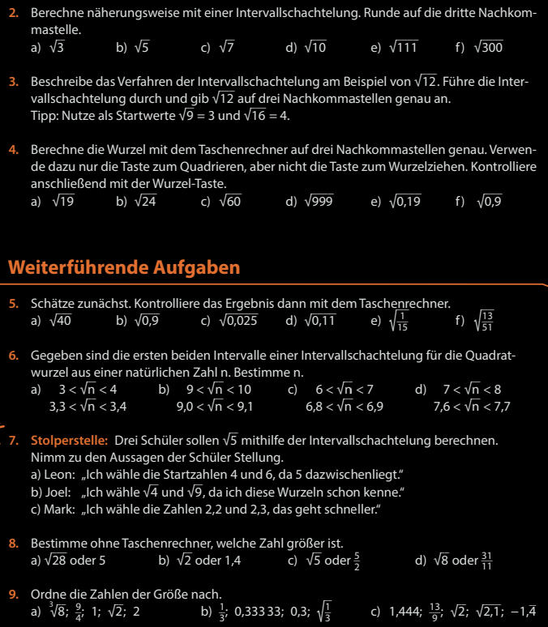
Fun47

Slide 7
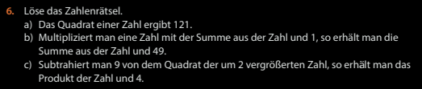

Fun55

