Slide 1
Mathematik Q1 Abels

Slide 2

$\frac{1}{4}⋅{\left(\frac{0}{4}\right)}^{2}+\frac{1}{4}⋅{\left(\frac{1}{4}\right)}^{2}+\frac{1}{4}⋅{\left(\frac{2}{4}\right)}^{2}+\frac{1}{4}⋅{\left(\frac{3}{4}\right)}^{2}=…$
$\frac{1}{4}⋅{\left(\frac{1}{4}\right)}^{2}+\frac{1}{4}⋅{\left(\frac{2}{4}\right)}^{2}+\frac{1}{4}⋅{\left(\frac{3}{4}\right)}^{2}+\frac{1}{4}⋅{\left(\frac{4}{4}\right)}^{2}=…$

Slide 3
Die Streifenmethode des Archimedes

Slide 4
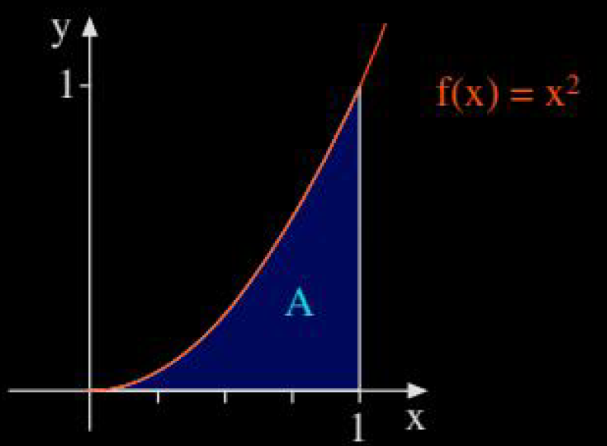
= …?

Slide 5
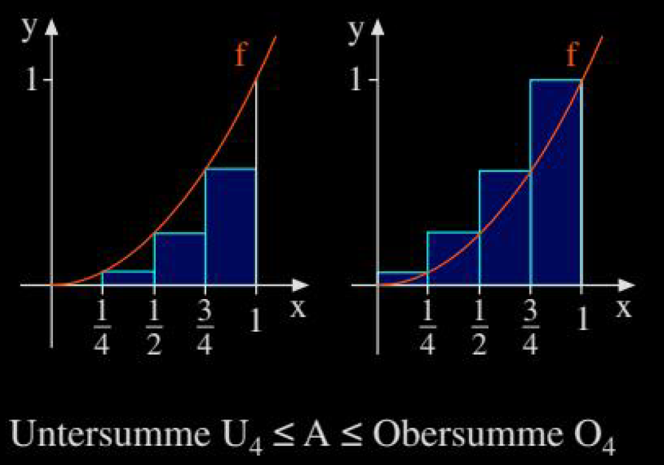
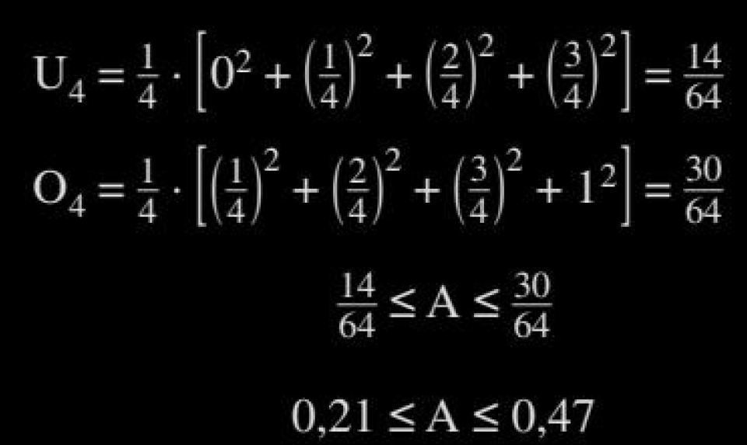
Streifenmethode: Einschachtelung

Slide 6
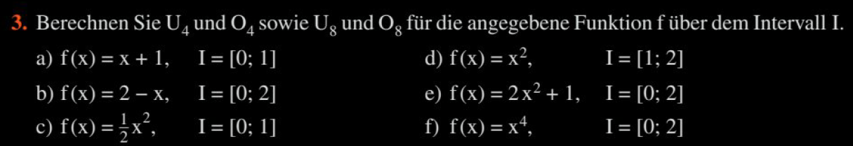
Big17

Slide 7

Big17
3.
$U_{4}=\frac{11}{8}=1.375, O_{4}=\frac{13}{8}=1.625, U_{8}=\frac{23}{16}=1.4375, O_{8}=\frac{25}{16}=1.5625$
$U_{4}=\frac{3}{2}=1.5, O_{4}=\frac{5}{2}=2.5, U_{8}=\frac{7}{4}=1.75, O_{8}=\frac{9}{4}=2.25$
$U_{4}=\frac{7}{64}=0.109375, O_{4}=\frac{15}{64}=0.234375, U_{8}=\frac{35}{256}≈0.14, O_{8}=\frac{51}{256}≈0.2$
$U_{4}=\frac{63}{32}=1.96875, O_{4}=\frac{87}{32}=2.71875, U_{8}=\frac{275}{128}≈2.15, O_{8}=\frac{323}{128}≈2.52$
$U_{4}=\frac{11}{2}=5.5, O_{4}=\frac{19}{2}=9.5, U_{8}=\frac{51}{8}=6.375, O_{8}=\frac{67}{8}=8.375$
$U_{4}=\frac{49}{16}=3.0625, O_{4}=\frac{177}{16}=11.0625, U_{8}=\frac{1169}{256}≈4.56, O_{8}=\frac{2193}{256}≈8.57$

Slide 8
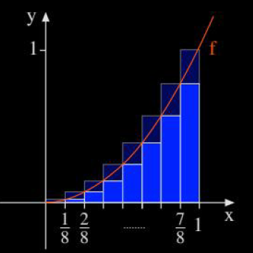
…?

Slide 9
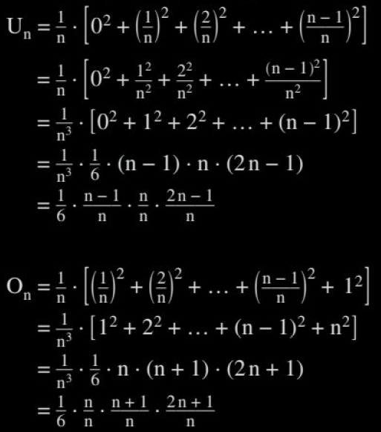
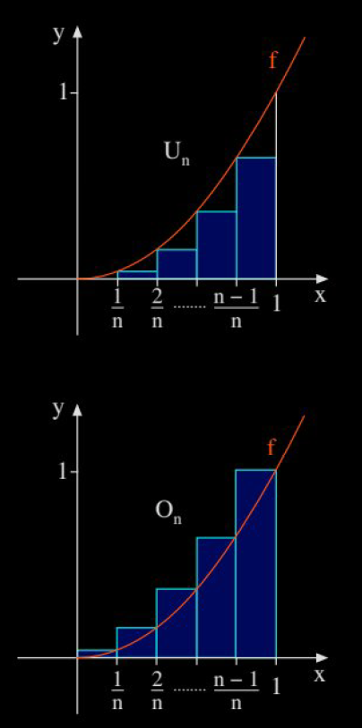


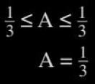
Streifenmethode: Exakt

Slide 10
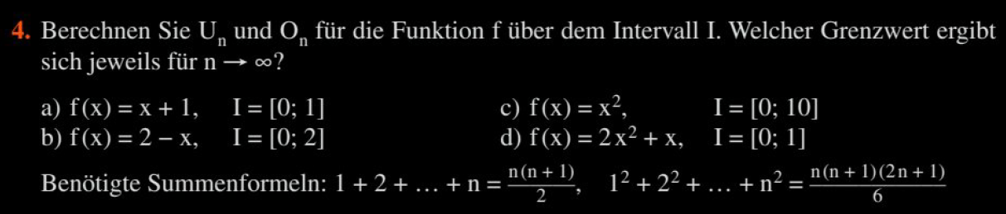
Big17

Slide 11

Big17
4.
$U_{n}=\frac{3n−1}{2n}\overset{→}{n→∞}\frac{3}{2}, O_{n}=\frac{3n+1}{2n}\overset{→}{n→∞}\frac{3}{2}$
$U_{n}=2−\frac{2}{n}\overset{→}{n→∞}2, O_{n}=2+\frac{2}{n}\overset{→}{n→∞}2$
$U_{n}=\frac{500}{3}⋅\frac{\left(n−1\right)\left(2n−1\right)}{n^{2}}\overset{→}{n→∞}\frac{1000}{3}, O_{n}=\frac{500}{3}⋅\frac{\left(n+1\right)\left(2n+1\right)}{n^{2}}\overset{→}{n→∞}\frac{1000}{3}$
$U_{n}=\frac{(n−1)(2n−1)}{3n^{2}}+\frac{n−1}{2n}\overset{→}{n→∞}\frac{7}{6}, O_{n}=\frac{\left(n+1\right)\left(2n+1\right)}{3n^{2}}+\frac{n+1}{2n}\overset{→}{n→∞}\frac{7}{6}$

Slide 12
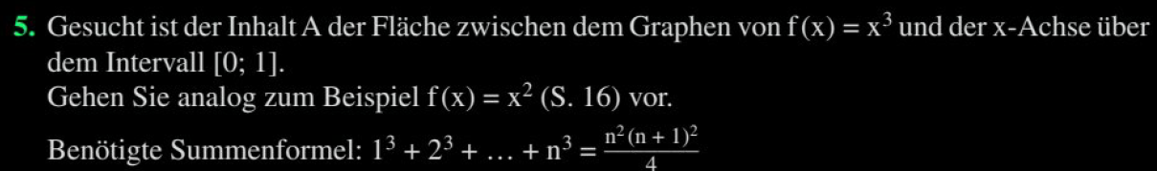
Big17

